Slide 1

Five things you can do today
to grow your obituary category

Slide 2

Obit State of the Union…
5 out of 10 people invest in a newspaper obituary for their loved ones today
Obit placement is declining at a rate of 10%+ for past 3 years
Most funeral homes offer an online obituary on their website
Costs for today’s funeral have escalated along with costs for obituaries
Social media has made it easier for people to connect
The Baby Boomer market will soon be impacting the funeral industry

Slide 3
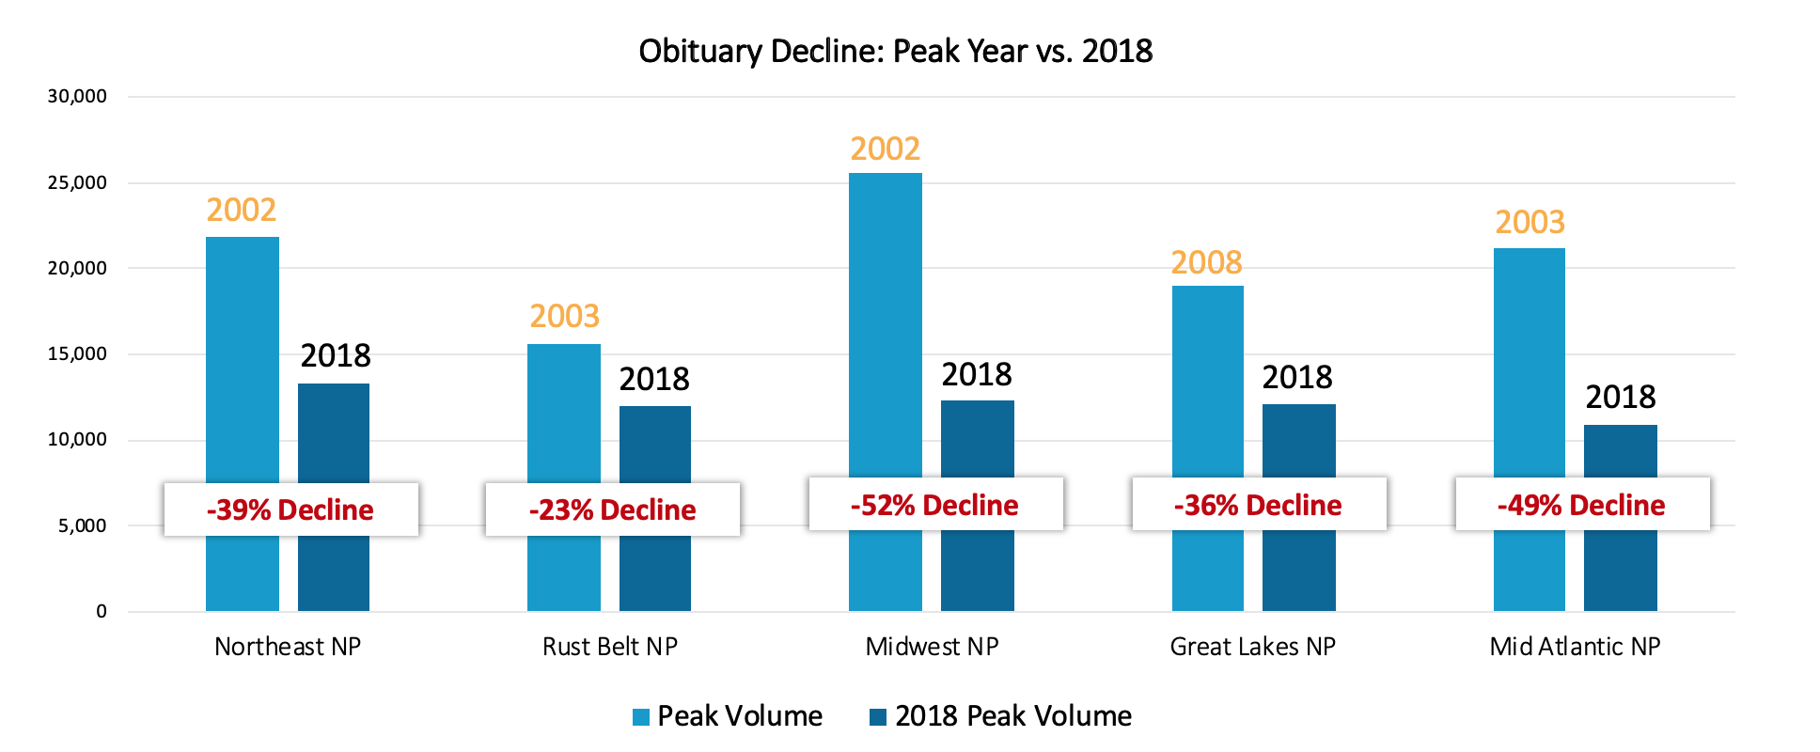

Slide 4
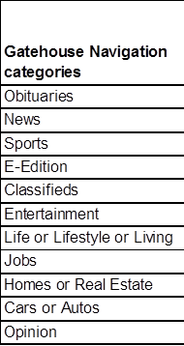

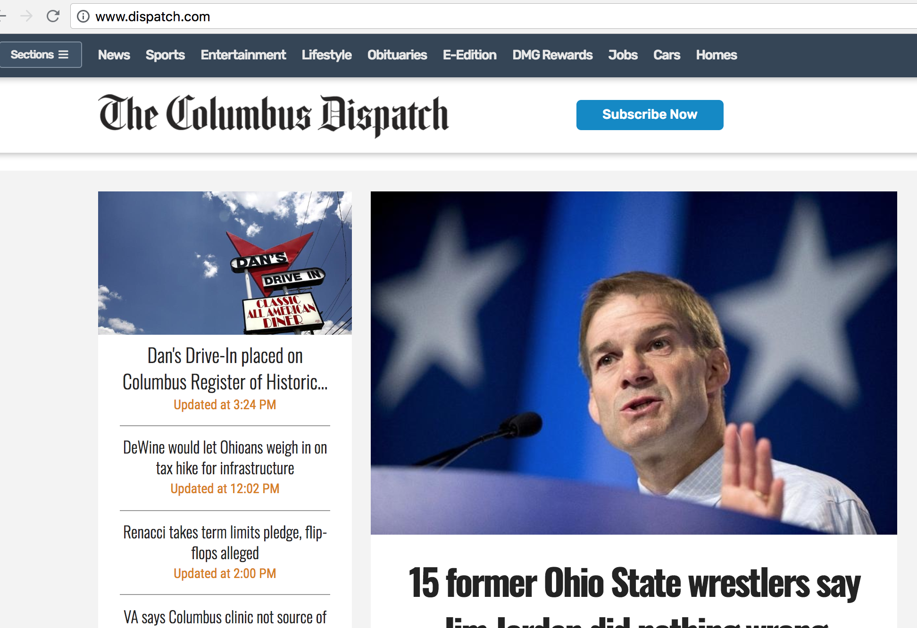
Obituaries engage more users than any other category
Case study shared courtesy of GateHouse media with January to May navigation bar data for 2018.

Slide 5
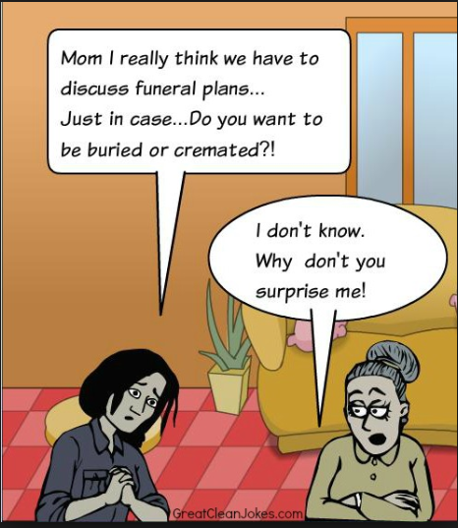
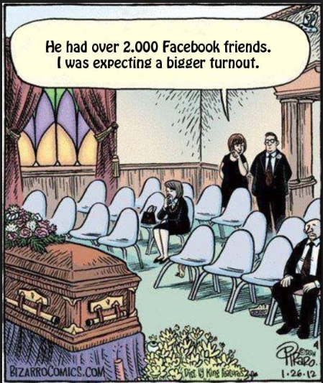
Funeral Directors are people too with a GREAT sense of Humor

Slide 6
1. Connect with your funeral homes and listen
Monitor market trends and placement gaps to understand high potential funeral homes
(ObitData if Legacy)
Visit 1:1 with your funeral homes
Invite your funeral homes to a thank you event
Build in time to understand their hurdles to placement
Re-educate on marketing value of placing
No time? Leverage our team to help
Legacy Funeral Home Channel Leadership
John Heald
SVP of Sales
Fourth Generation Funeral Home Director
“If there’s no cars in the parking lot, then a funeral director will usually make time for you.”
- John Heald

Slide 8
2. Incentivize your funeral homes
Rebates to funeral home
Discounts for families
Exclusive packages
Commissions to directors
Special ad features (logo)

Slide 9
3. Offer creative pricing packages
Charts are popular for free options
Low cost options can range from chart simplicity to a few lines
Under $100 fits with cost expectations in most markets
$50 and under is appealing to funeral homes to pay out of pocket
Want more volume? Consider offering funeral homes a subscription model

Slide 10
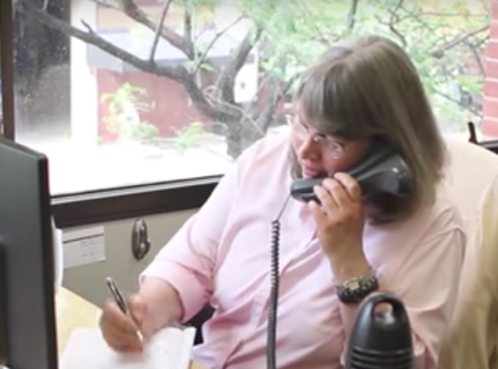
4. Make it easier to place obituaries
Simplify your offering
Expand hours and coverage especially nights and weekends
Move from Newsroom to Classifieds
Easy self-serve tools

Slide 11
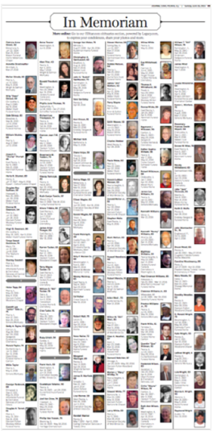
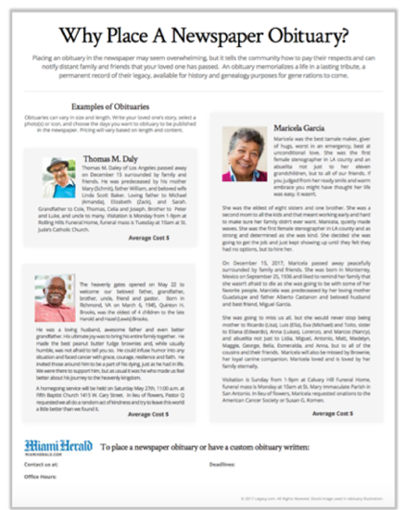
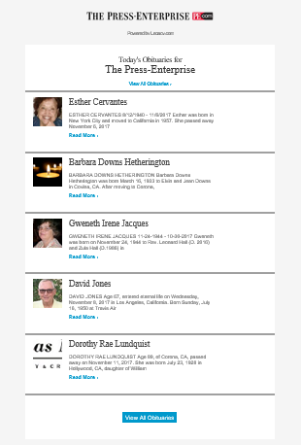
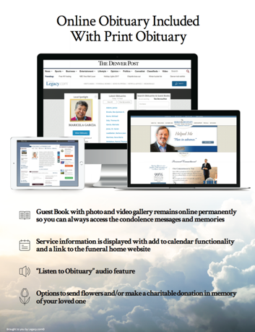
5. Help families picture the value
Sales Aids
House Ads
E-Newsletter
In-Memoriam Sections

Slide 12
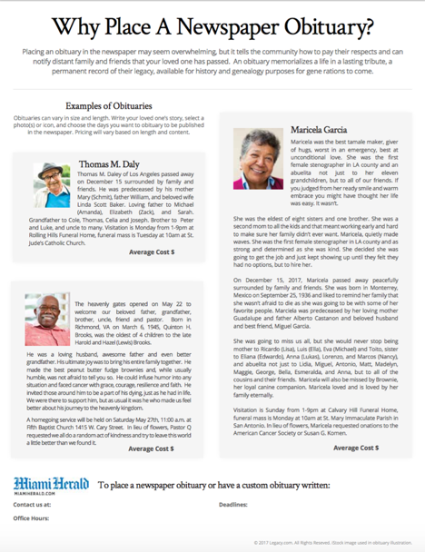
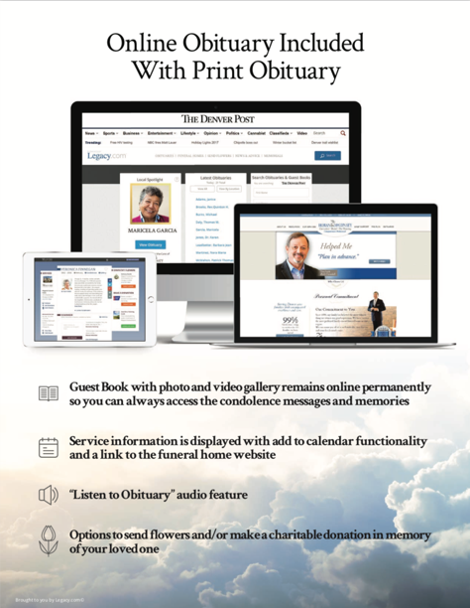
Custom sales pieces ease funeral home channel placements
While the vast majority of people would like to place a newspaper obituary the process may be challenging, custom pieces can engage families in seeing the value of the obituary and lower cost anxiety about placement.

Slide 13
Thank you!
Ron Speechley
rspeechley@legacy.com
815.557.5372
Want more info?... sales.legacy.com

